Slide 1


Mobile Ecosystems and Development Environments
Lecture-02
Course Code: CSE413
Course Title: Mobile Application Design

Slide 2



Learning Outcomes
Overview of mobile OS architectures
Introduction to SDKs (Android SDK, iOS SDK)
Role of SDK tools in supporting app design and development

Slide 3
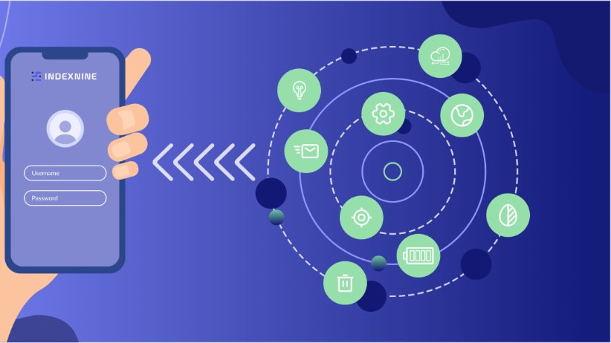
What is Mobile Ecosystem?
A mobile ecosystem refers to the interconnected network of devices, software, services, technologies, and stakeholders that work together to enable and support mobile communication, computing, and applications. It is a dynamic environment where various elements interact to provide a seamless experience for users, developers, manufacturers, and service providers.

Slide 4
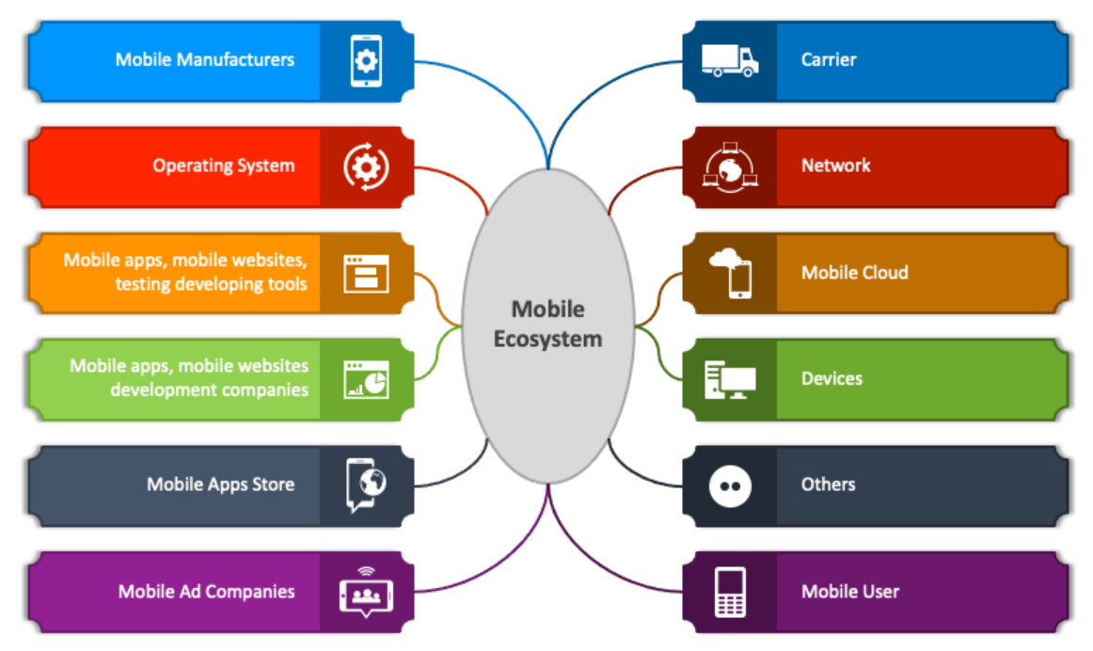
Mobile Ecosystem: Key Components

Slide 5



Mobile Ecosystem: Key Components
Mobile Manufacturers: Companies like Samsung, Apple, and Huawei that produce smartphones and tablets
Operating System: Software platforms like Android and iOS that power mobile devices
Mobile Apps, Mobile Websites, and Testing Tools: Applications and websites specifically designed for mobile platforms, along with tools for testing them
Mobile Development Companies: Organizations that create mobile applications and websites

Slide 6


Mobile Ecosystem: Key Components
Mobile Apps Store: Platforms like Google Play Store and Apple App Store that distribute applications to users
Mobile Ad Companies: Businesses that manage advertising on mobile platforms
Carrier: Network providers such as AT&T, Verizon, or T-Mobile that enable connectivity
Network: Infrastructure for data transfer, including 4G, 5G, and Wi-Fi

Slide 7


Mobile Ecosystem: Key Components
Mobile Cloud: Cloud services for storage, processing, and app integration
Devices: Hardware like smartphones, tablets, and wearables
Mobile Users: End-users who interact with mobile devices and apps
Others: Any additional stakeholders or technologies supporting the ecosystem

Slide 8

Mobile OS Architectures
iOS
Proprietary System: Developed exclusively by Apple, ensuring uniformity.
User Experience: Emphasizes seamless design and high performance.
Security: Advanced encryption and app review processes for heightened safety.
Hardware Integration: Designed to work specifically with Apple devices like iPhones, iPads, and Apple Watch.
Development Tools: Xcode with Interface Builder and seamless App Store deployment.

Slide 9
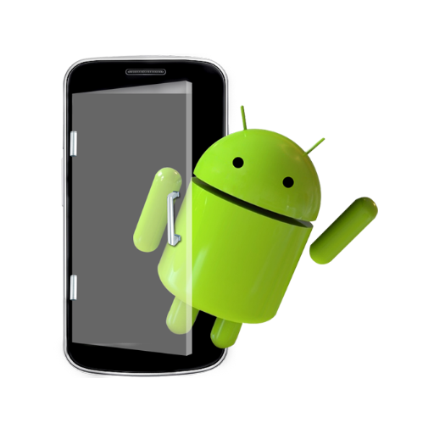
Mobile OS Architectures
Android
Open Source: Based on Linux, allowing for greater customization.
Hardware Support: Compatible with various manufacturers like Samsung, Xiaomi, and OnePlus.
App Scalability: Supports a wide range of screen sizes and device configurations.
Ecosystem: Integration with Google services like Gmail, Drive, and Maps.
Development Tools: Android Studio with extensive debugging tools and emulators.

Slide 10
Introduction to SDKs
Android SDK
Core Components
Emulator: Simulates Android devices for app testing.
Debugger: Identifies and resolves code errors effectively.
APIs: Provides access to hardware features like camera, sensors, and GPS.
Build Tools: Assists in compiling, packaging, and deploying apps.
Supported Languages: Java, Kotlin, and C++.
Strengths:
Compatibility with a variety of Android devices and manufacturers.
Rich ecosystem of libraries and tools for rapid development.
Integration with Google services (e.g., Firebase, Google Maps).

Slide 11
Introduction to SDKs
iOS SDK
Core Components:
Interface Builder: Enables visual design of app interfaces.
APIs: Offers access to Apple-specific features like Siri, ARKit, and Face ID.
Simulators: Allows testing across various Apple devices (iPhones, iPads, etc.).
Integrated Debugging Tools: Built into Xcode for efficient error detection.
Supported Languages: Swift and Objective-C.
Strengths
Seamless integration with Apple’s hardware and software ecosystem.
Focus on security and performance optimization.
Unified environment for consistent app development and deployment.

Slide 12
Role of SDK tools in supporting app design and development
Design Support:
Offers tools for prototyping and refining UI/UX.
Ensures apps are responsive and accessible across devices.
Development Support:
Provides pre-built libraries and frameworks to simplify coding.
Offers testing environments for debugging and app performance analysis.
Deployment Support:
Streamlines publishing apps to Google Play Store and Apple App Store.
Helps maintain version compatibility across updates.

Slide 13
Thank You

